Slide 1
Why we censor
Tom’s bit

Slide 2
Religion

Slide 3
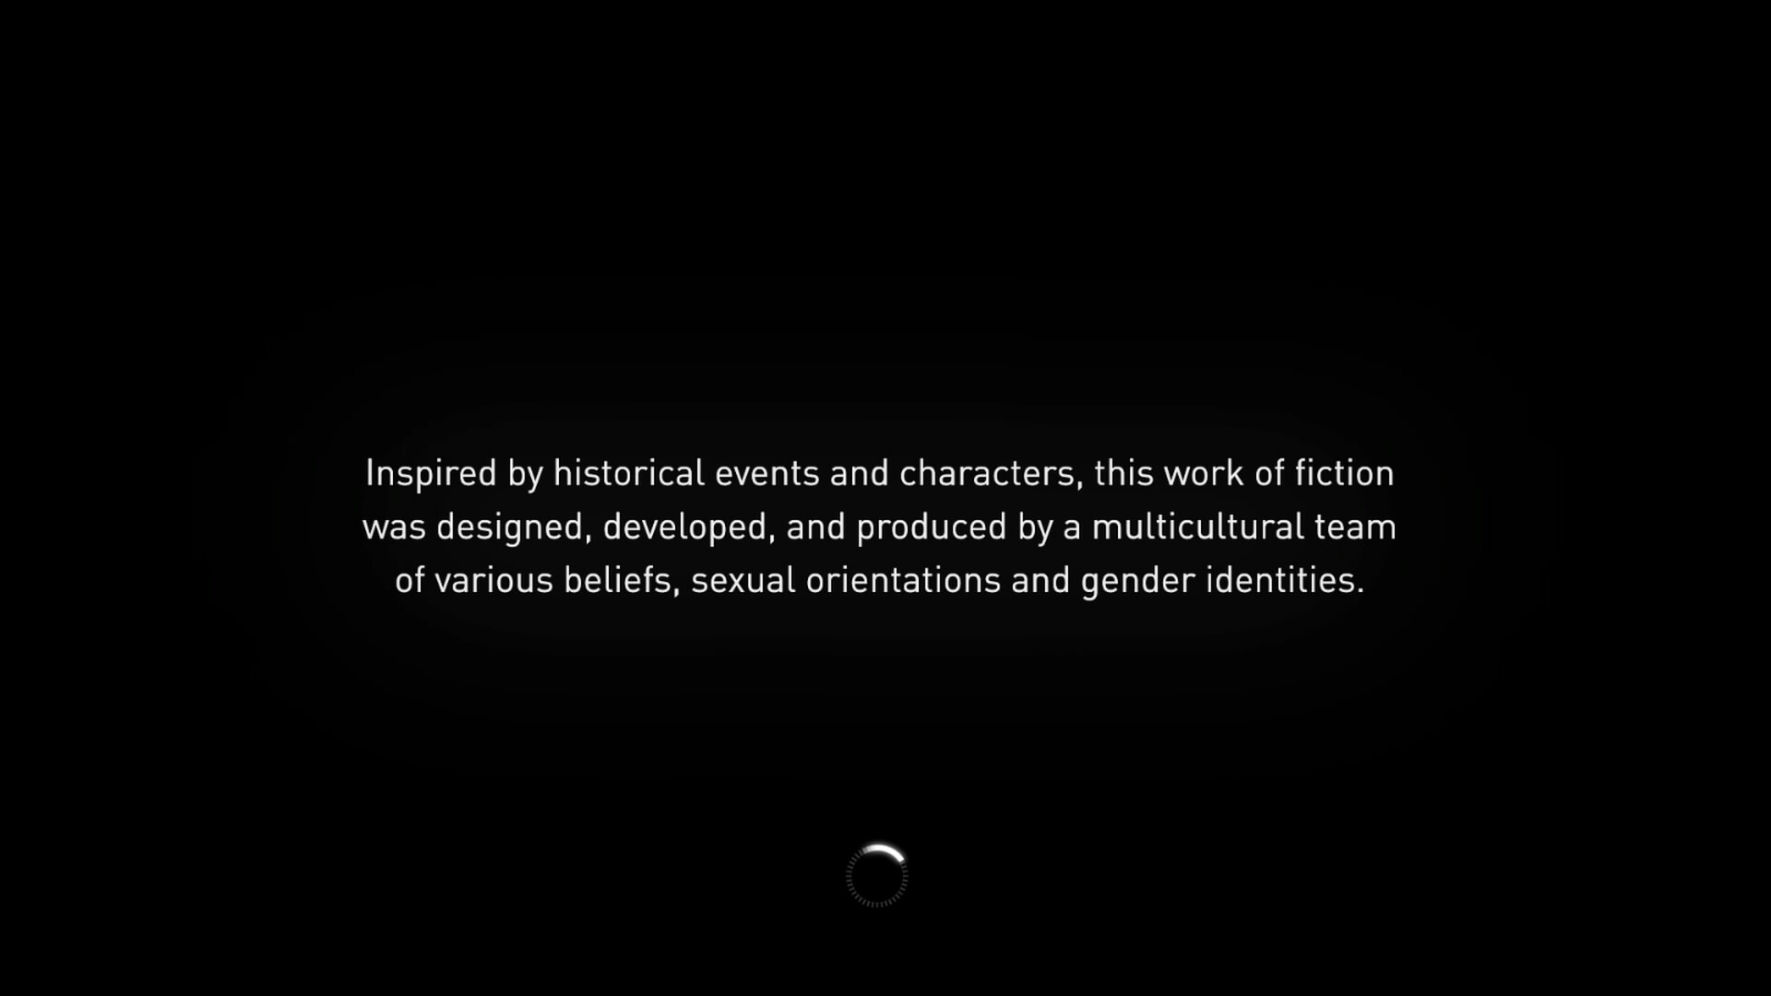
Religion

Slide 4
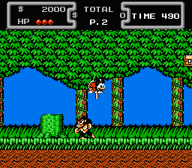

Slide 5
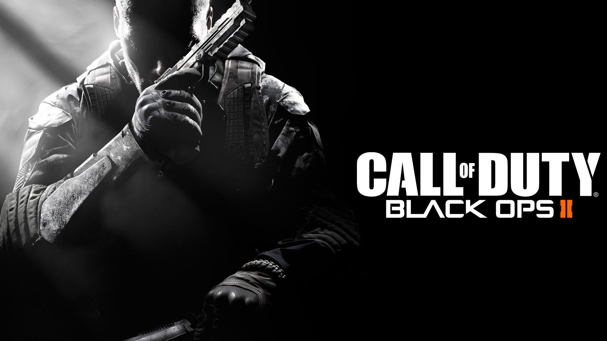






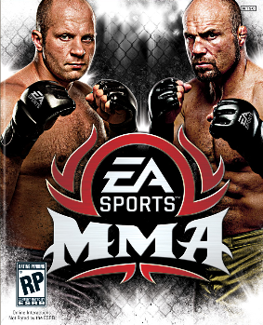










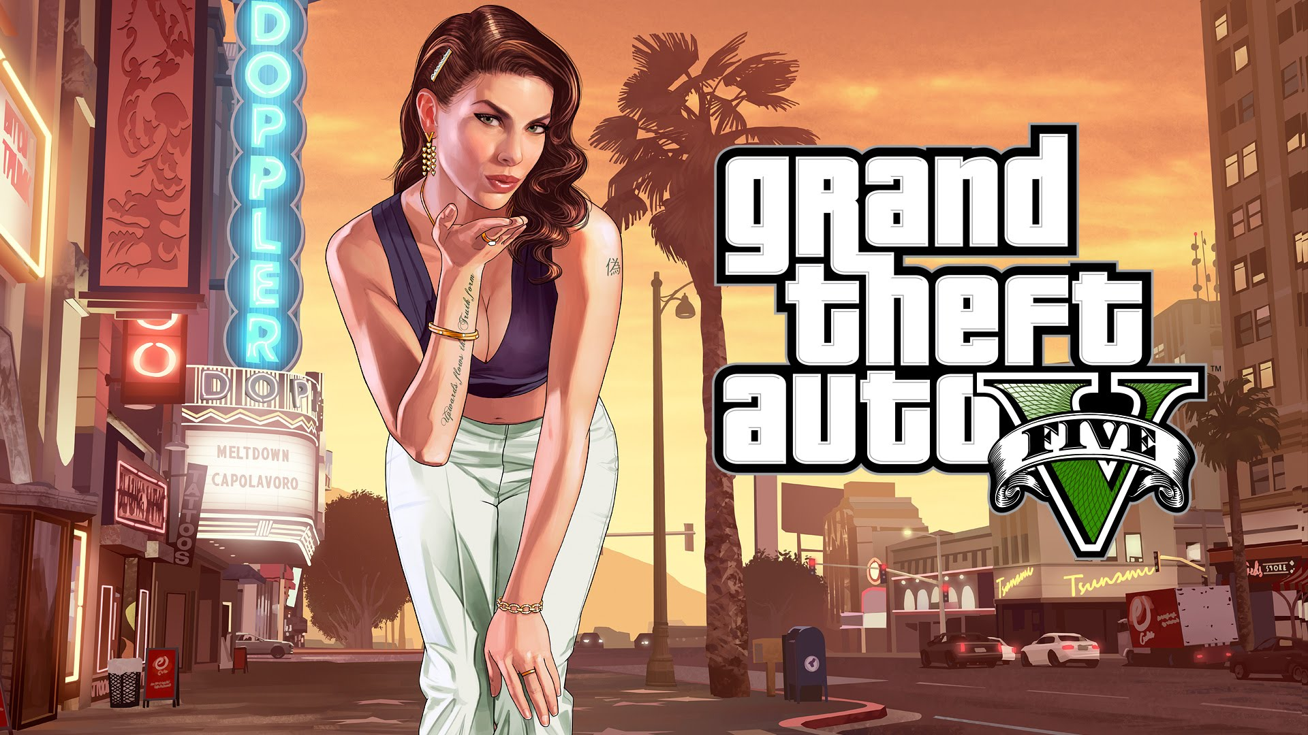





Slide 6
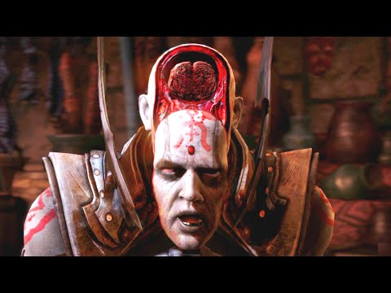
Politics

Slide 7
Do you have a ‘line’ of what is and isn’t acceptable?

Slide 8
Do you have a ‘line’ of what is and isn’t acceptable?
Sexual themes?
Rape?
Child Pornography?
Over the Top gore?
Religious Slurrs

Slide 9

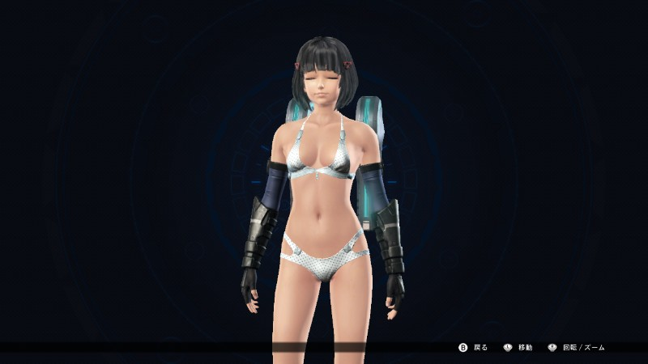
Xenoblade
American release Japanese release

Slide 10

Morals

Slide 11
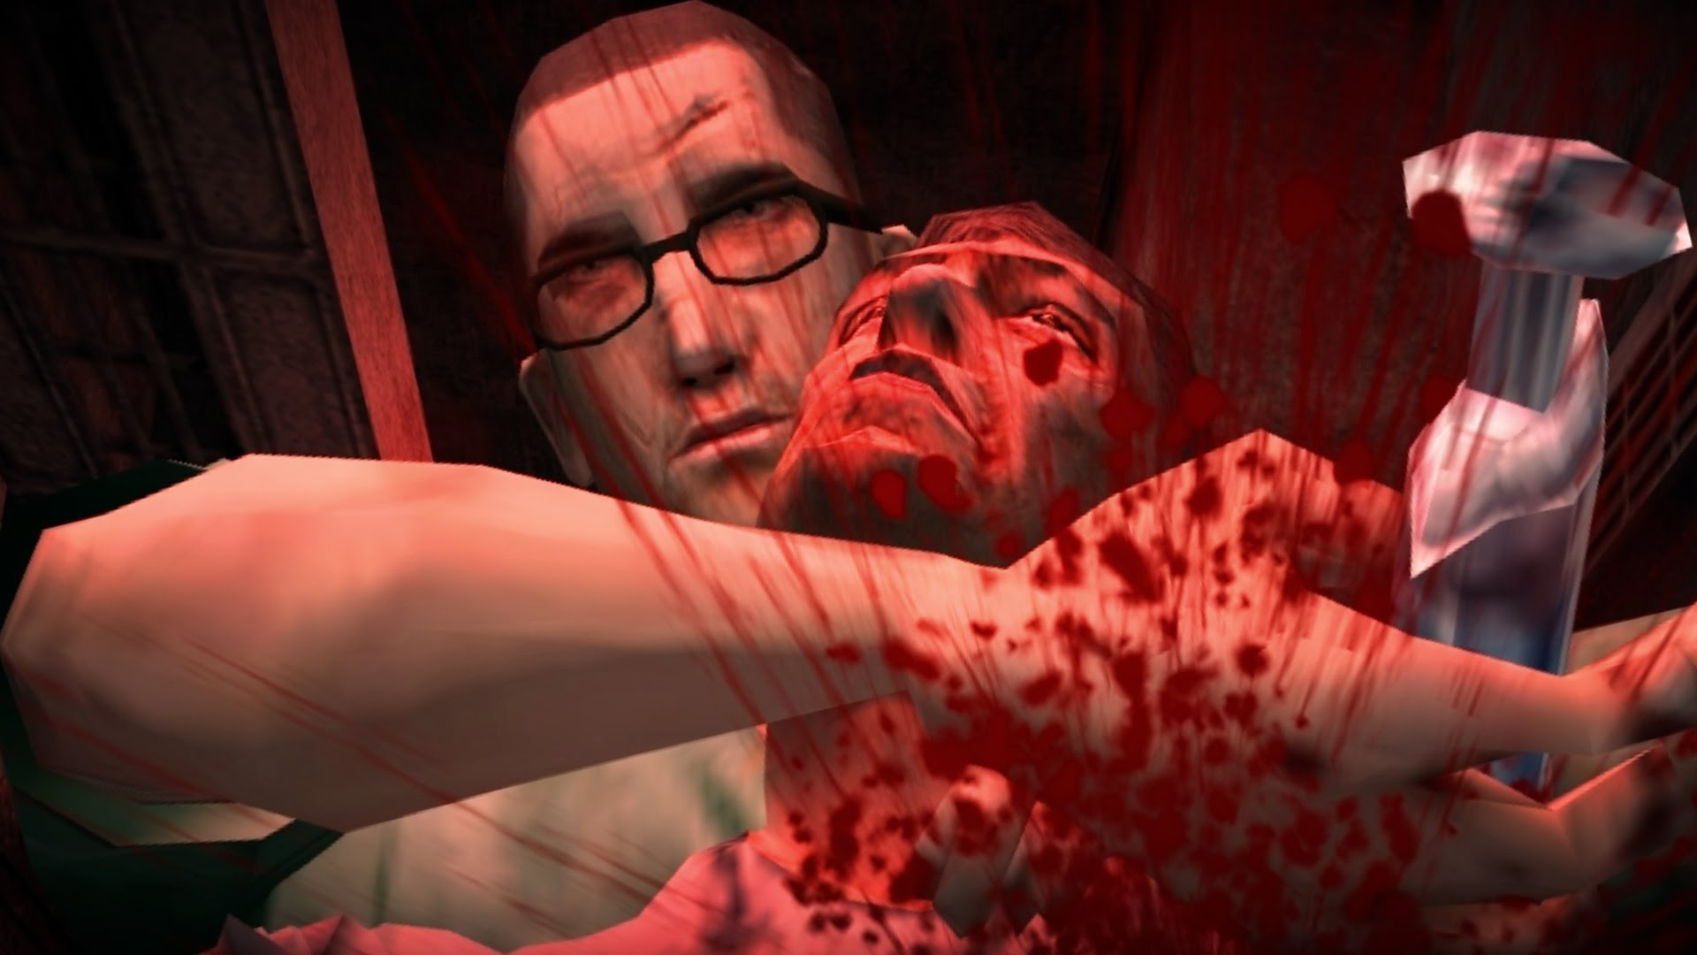
Manhunt 2
Censored: https://www.youtube.com/watch?v=smajP99B5xA
Uncensored: https://www.youtube.com/watch?v=x6LwaLHz5Xk

Slide 12
Mortal Kombat X
https://www.youtube.com/watch?v=2YxPFw7lfY0

Slide 13
What do you think the reason Manhunt was banned but not Mortal Kombat X?

Slide 14
What do you think the reason Manhunt was banned but not Mortal Kombat X?
First Person?
Graphics?
Reality?
Just moving with the times

Slide 15


Financial Gains

Slide 16

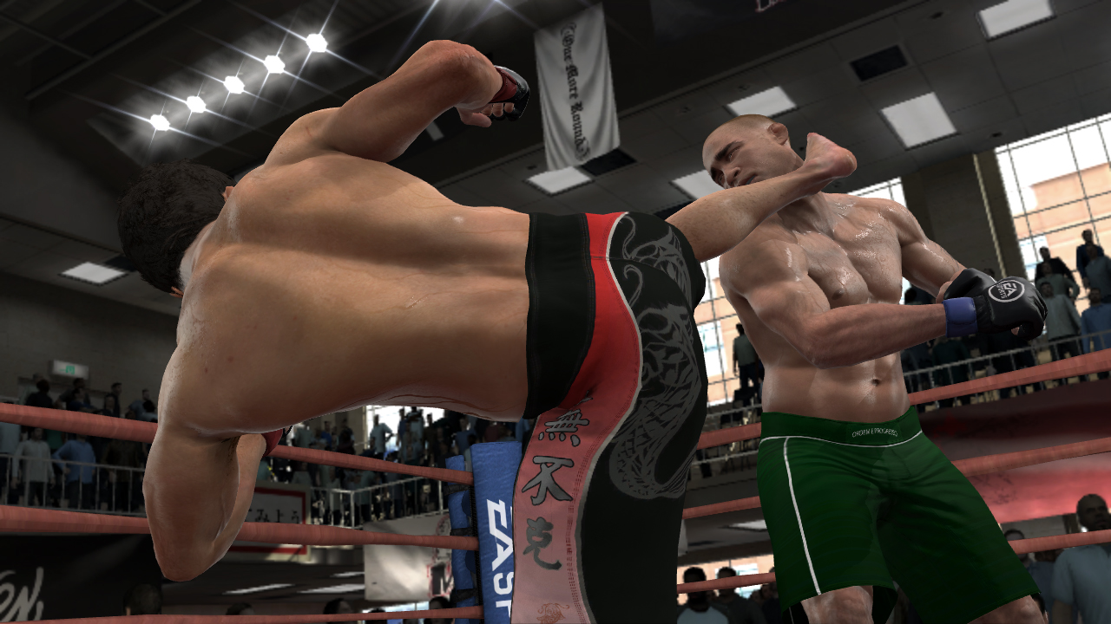

Slide 17
